Slide 1
Unit III– Sequential Logic Circuit
Basic Memory Cell: RS Latch- using NAND & NOR.
Triggering Methods: Edge Trigger & Level Trigger.
SR Flip Flops: SR Flip Flop, Clocked SR FF with preset & clear, Drawbacks of SR FF
JK Flip Flops: Clocked JK FF with preset & clear, Race around condition in JK FF, Master Slave JK FF, D and T type Flip Flop, Excitation Tables of Flip Flops, Block schematic and function table of IC 7474, IC 7475.
‹#›

Slide 2
Unit III – Sequential Logic Circuit
Shift Register: Logic diagram of 4 bit shift registers - SISO, SIPO,
PIPO, PISO, 4 Bit Universal Shift Registers.
Counters: Asynchronous Counter: 4 bit Ripple Counter, 4 Bit Up/Down Counter, Modulus of counter, Synchronous Counter: Design of 4 bit Synchronous up/down counter. Decade Counter: Block schematic of IC 7490, IC 7490 as MOD-N Counter, Ring Counter and Twisted Ring Counter
‹#›

Slide 3
Unit-III Sequential Logic Circuits
‹#›

Slide 4
Unit Outcomes
Use relevant triggering technique for the given digital circuit.
Use the given flip flop to construct the specific type of counter.
Use excitation table of the given flip flop to design synchronous counter.
Design the specified modulo-N counter using IC 7490.
Construct ring/twisted ring counter using the given flip flop.
‹#›

Slide 5




Combinational Circuits Vs Sequential Circuits
Logic circuits are classified into two groups:
Combinational logic circuits
Logic gates make decisions
Basic building
blocks include Gates:
Sequential logic circuits
Flip Flops have memory
Basic building blocks include FLIP-FLOPS:
‹#›

Slide 6
Combinational Circuits Vs Sequential Circuits
x₁ x_{n}
Combinational logic
z₁ z_{m}
(a)
x₁ x_{n}
Combinational logic
z₁ z_{m}
y₁ y_{r}
Y_{r} Y₁
Memory
(b)
‹#›

Slide 7
Combinational Circuits Vs Sequential Circuits
Combinational Circuits Sequential Circuits
^{In combinational circuits,} ✔ In sequential circuits, the
any are
the output variables at any
output variables at instant of time
instant of time are
the
dependent only on
dependent not only on the present input variables but also past output variables.
present input variables.
Memory unit is not required in combinational circuits.
Memory unit is required to
store the past history.
‹#›

Slide 8
Combinational Circuits Vs Sequential Circuits
Combinational Circuits Sequential Circuits
^{Combinational circuits are} ✔ Sequential circuits are
faster because
the delay the input and is due to
slower than combinational circuits.
between output
propagation delay of gates only.
Sequential comparatively design.
circuits are harder to
Combinational circuits are easy to design.
‹#›

Slide 9
Unit III– Sequential Logic Circuit
Basic Memory Cell: RS Latch- using NAND & NOR.
Triggering Methods: Edge Trigger & Level Trigger.
SR Flip Flops: SR Flip Flop, Clocked SR FF with preset & clear, Drawbacks of SR FF
JK Flip Flops: Clocked JK FF with preset & clear, Race around condition in JK FF, Master Slave JK FF, D and T type Flip Flop, Excitation Tables of Flip Flops, Block schematic and function table of IC 7474, IC 7475.
‹#›

Slide 10
What is exactly Memory?
A memory should operations:
support at least three
It should be able to hold a value
You should be able to read the value that is saved
You should be able to change that value
‹#›

Slide 11
Simple case - One bit memory
We will start with simplest case, a one bit memory:
  It should be able to hold a single bit, 0 or 1.
  You should be able to read the bit that is saved.
  You should be able to change the bit.
    You can set the bit to 1
    You can reset or clear the bit to 0.
‹#›

Slide 12
Basic Idea of Storage
How can a circuit remember anything, when its just a bunch of gates that produce outputs according to inputs?
The idea is to make a loop in a circuit, so outputs are also inputs.
“1”
bistable cell
(Stored Value= state)
“0”
Two inverters and a feedback loop form a “Static ” storage cell
The cell will hold value as long as it has power applied
‹#›

Slide 13
Basic Idea of Storage
How to get a new value into a storage cell?
  Selectively break feedback path
  Load new value into cell
“remember”
“load”
“data”
“Stored Value”
‹#›

Slide 14
One Bit Memory Cell
Q
Q
The output of each gate is connected to the input of the other gate . This feedback connection is known as “Flip Flop”.
‹#›

Slide 15
One Bit Memory Cell
It has two stable states which are known as 1 (HIGH) state and 0 (LOW) state.
Since flip flop has two stable states, it is called a Binary or Bistable.
Similarly it stores 1 bit information; either 1 or 0.
it is a 1 bit memory unit or a 1 bit storage cell.
Since information is locked or latched, 1 bit memory cell is also known as LATCH.
‹#›

Slide 16
Latch
Latch are the bi-stable devices which responds to the change of input logic levels as they occur.
Q
Q is the primary
output
Latch
Inputs
Q is its complementary output
Q
It is said to be in SET state if output Q is High It is said to be in RESET state if output Q is Low
‹#›

Slide 17

RS Latch using NOR
R
Q
Q
S
Circuit Diagram
R
Q
Inputs
Outputs
S
Q
9/11/2018
Symbol
32

Slide 18
RS Latch using NOR
Logic Table
S | R | Q_{n} | ^{Q}n+1 | State
0 | 0 | 0 | 0 | No Change
0 | 0 | 1 | 1
0 | 1 | 0 | 0 | Reset
0 | 1 | 1 | 0
1 | 0 | 0 | 1 | Set
1 | 0 | 1 | 1
1 | 1 | 0 | X | Indetermine
1 | 1 | 1 | X
9/11/2018
33

Slide 19

RS Latch using NAND
R
Q
Q
S
Circuit Diagram
R
Q
Inputs
Outputs
S Q
Symbol
9/11/2018
34

Slide 20
RS Latch using NAND
Logic Table
S | R | Q_{n} | ^{Q}n+1 | State
0 | 0 | 0 | X | Indetermine
0 | 0 | 1 | X
0 | 1 | 0 | 0 | Reset
0 | 1 | 1 | 0
1 | 0 | 0 | 1 | Set
1 | 0 | 1 | 1
1 | 1 | 0 | 0 | No Change
1 | 1 | 1 | 1
9/11/2018
35

Slide 21
RS Latch using NAND with additional circuitry
R
S’
Q
Q
S
R’
Circuit Diagram
R
Q
Inputs
Outputs
S Q
Symbol
9/11/2018
36

Slide 22
RS Latch using NAND with additional circuitry
Logic Table
S | R | Q_{n} | ^{Q}n+1 | State
0 | 0 | 0 | 0 | No Change
0 | 0 | 1 | 1
0 | 1 | 0 | 0 | Reset
0 | 1 | 1 | 0
1 | 0 | 0 | 1 | Set
1 | 0 | 1 | 1
1 | 1 | 0 | X | Indetermine
1 | 1 | 1 | X
‹#›

Slide 23
Unit III – Sequential Logic Circuit
Basic Memory Cell: RS Latch- using NAND & NOR.
Triggering Methods: Edge Trigger & Level Trigger.
SR Flip Flops: SR Flip Flop, Clocked SR FF with preset & clear, Drawbacks of SR FF
JK Flip Flops: Clocked JK FF with preset & clear, Race around condition in JK FF, Master Slave JK FF, D and T type Flip Flop, Excitation Tables of Flip Flops, Block schematic and function table of IC 7474, IC 7475.
‹#›

Slide 24
Clock
A clock is a special device that
continuously alternates between 0 and 1.
whose
output
The time it takes the clock to change from 1 to 0 and
back to 1 is called the clock period, or clock cycle time.
Clocks are often used to synchronize circuits.
clock period
‹#›

Slide 25
Triggering
Sequential circuits are dependent on clock pulses applies to their inputs.
The result of flip-flop responding to a clock input is called clock pulse triggering, of which there are four types. Each type responds to a clock pulse in one of four ways:-
  High level triggering
  Low level triggering
  Positive edge triggering
  Negative edge triggering
‹#›

Slide 26
High Level Triggering
A flip flop who responds to a clock signal during the time at which it is in the logic High state.
Triggers on High clock level
Q
CLK
Q
Symbol
‹#›

Slide 27

Low Level Triggering
A flip flop who responds to a clock signal during the time at which it is in the logic Low state.
Triggers on Low clock level
Q
CLK
Q
Symbol
‹#›

Slide 28
Positive Edge Triggering
A flip flop who responds to a clock signal during Low to High transition of clock pulse.
Triggers on this edge of clock pulse
Q
CLK
Q
Symbol
‹#›

Slide 29
Negative Edge Triggering
A flip flop who responds to a clock signal during High to Low transition of clock pulse.
Triggers on this edge of clock pulse
Q
CLK
Q
Symbol
‹#›

Slide 30
Unit III – Sequential Logic Circuit
Basic Memory Cell: RS Latch- using NAND & NOR.
Triggering Methods: Edge Trigger & Level Trigger.
SR Flip Flops: SR Flip Flop, Clocked SR FF with preset & clear, Drawbacks of SR FF
JK Flip Flops: Clocked JK FF with preset & clear, Race around condition in JK FF, Master Slave JK FF, D and T type Flip Flop, Excitation Tables of Flip Flops, Block schematic and function table of IC 7474, IC 7475.
‹#›

Slide 31
Gates Vs Flip Flops
Gates are the building block of the logic circuits. Their primary function is to perform decision making operations.
Flip-flops are the building blocks of the digital circuits. Their primary function is to store the binary bits.
‹#›

Slide 32
Flip Flops
A flip-flop is a bi-stable device, with inputs, that remains in a given state as long as power is applied and until input signals are applied to cause its output to change.
There are four basic different types of flip-flops:
  SR Flip Flop
  D Flip Flop
  JK Flip Flop
  T Flip Flop
‹#›

Slide 33

SR Flip Flop
R
Q
R
Q
SR-FF
S
Q
Q
S
Circuit Diagram
Symbol
‹#›

Slide 34
SR Flip Flop
Logic Table
S | R | Q_{n} | ^{Q}n+1 | State
0 | 0 | 0 | X | Indetermine
0 | 0 | 1 | X
0 | 1 | 0 | 0 | Reset
0 | 1 | 1 | 0
1 | 0 | 0 | 1 | Set
1 | 0 | 1 | 1
1 | 1 | 0 | 0 | No Change
1 | 1 | 1 | 1
‹#›

Slide 35
Unit III– Sequential Logic Circuit
Basic Memory Cell: RS Latch- using NAND & NOR.
Triggering Methods: Edge Trigger & Level Trigger.
SR Flip Flops: SR Flip Flop, Clocked SR FF with preset & clear,
Drawbacks of SR FF
JK Flip Flops: Clocked JK FF with preset & clear, Race around condition in JK FF, Master Slave JK FF, D and T type Flip Flop, Excitation Tables of Flip Flops, Block schematic and function table of IC 7474, IC 7475.
‹#›

Slide 36
Clocked SR Flip Flop
S
R’
Q
R
Q
CLK
CLK
SR-FF
S
Q
Q
R
S’
Circuit Diagram
Symbol
‹#›

Slide 37
Clocked SR Flip Flop
Logic Table
CLK | S | R | Q | Q | State
 | 0 | 0 | Q | Q | No Change
 | 0 | 1 | 0 | 0 | Reset
 | 1 | 0 | 0 | 1 | Set
 | 1 | 1 | X | X | Prohibited
 | X | X | Q | Q | No Change
‹#›

Slide 38
Synchronous Inputs
The S and R (for SR FF), D (for D FF), J and K (JK FF), and so on….,inputs are control inputs.
These inputs are also called “Synchronous Inputs” because the action of these inputs are synchronized with the action of clock.
The flip flop changes state only on the application of clock signal.
‹#›

Slide 39
Asynchronous Inputs
In addition to synchronous inputs the flip flops have one or more asynchronous inputs .
These asynchronous inputs operate independently of control and clock input.
Two asynchronous inputs are ^{PRESET} and
CLEAR
These are mostly active LOW inputs.
‹#›

Slide 40
Clocked SR Flip Flop with Clear and Preset Inputs
PR
S
Q
CLK
Q
R
CR
‹#›

Slide 41
Asynchronous Inputs: ^{PRESET} and ^{CLEAR}
Sr. No. | Action | Function/Operation
1 | PRESET = 1 CLEAR = 1 | Both these asynchronous inputs are inactive. The flip flop responds to synchronous inputs.
2 | PRESET = 0 CLEAR = 1 | The PRESET is activated and Q is immediately set to 1 irrespective of synchronous inputs. The clock input cannot affect the flip flop when PR=0.
3 | PRESET = 1 CLEAR = 0 | The CLEAR is activated and Q is immediately cleared to 0 irrespective of synchronous inputs. The clock input cannot affect the flip flop when CR=0.
4 | PRESET = 0 CLEAR = 0 | This condition should not be used as it leads to race condition
‹#›

Slide 42
Clocked SR Flip Flop with Clear and Preset Inputs
PR
Inputs |  |  |  |  | O/P |  | Comment
CLK | CR | PR | S | R | Q | Q
 | 1 | 1 | 0 | 0 | Q | Q | No Change
 | 1 | 1 | 0 | 1 | 0 | 1 | Reset
 | 1 | 1 | 1 | 0 | 1 | 0 | Set
 | 1 | 1 | 1 | 1 | X | X | Invalid
X | 0 | 1 | X | X | 0 | 1 | Clear
X | 1 | 0 | X | X | 1 | 0 | Preset
X | 0 | 0 | X | X | X | X | Invalid
R
S
Q
SR-FF
Q
CR
‹#›

Slide 43
Synchronous Sequential Circuits Vs Asynchronous
Sequential Circuits
Synchronous Seq Circuits Asynchronous Seq Circuits
^{In Synchronous circuits,} ✔ In Asynchronous circuits,
^{memory elements are} memory clocked FFs.
elements are
either unclocked FFs or time
delay elements.
In Synchronous circuits, the change in input signals can
In Asynchronous circuits,
the change in input signals
affect upon
memory elements activation of clock
can affect memory elements at any instant of time.
signals.
‹#›

Slide 44
Synchronous Sequential Circuits Vs Asynchronous
Sequential Circuits
Synchronous Seq Circuits Asynchronous Seq Circuits
The maximum operating speed of the clock depends on time delays involved
Because of the absence of
the clock, asynchronous
circuits can operate faster
than synchronous circuits.
Easier to design
More difficult to design
‹#›

Slide 45
Unit III – Sequential Logic Circuit
Basic Memory Cell: RS Latch- using NAND & NOR.
Triggering Methods: Edge Trigger & Level Trigger.
SR Flip Flops: SR Flip Flop, Clocked SR FF with preset & clear,
Drawbacks of SR FF
JK Flip Flops: Clocked JK FF with preset & clear, Race around condition in JK FF, Master Slave JK FF, D and T type Flip Flop, Excitation Tables of Flip Flops, Block schematic and function table of IC 7474, IC 7475.
‹#›

Slide 46
Drawbacks of SR Flip Flop
If both inputs are pulled down to logic level 0, both outputs will be at logic level 1. This state should not be allowed to occur in flip-flops.
‹#›

Slide 47
Unit III – Sequential Logic Circuit
Basic Memory Cell: RS Latch- using NAND & NOR.
Triggering Methods: Edge Trigger & Level Trigger.
SR Flip Flops: SR Flip Flop, Clocked SR FF with preset & clear, Drawbacks of SR FF
JK Flip Flops: Clocked JK FF with preset & clear, Race around condition in JK FF, Master Slave JK FF, D and T type Flip Flop, Excitation Tables of Flip Flops, Block schematic and function table of IC 7474, IC 7475.
‹#›

Slide 48
Level Triggered JK Flip Flop
SR Flip Flop
Q
J
R’
3
1
Q
CLK
2
Q
4
S’
K
Q
J
K
Q
JK-FF
Q
Circuit Diagram of Level Triggered JK Flip Flop
CLK
Symbol
9/11/2018
63

Slide 49
Level Triggered JK Flip Flop
Inputs |  |  | Outputs |  | State
CLK | J | K | Qn + 1 | Qn + 1
0 | X | X | Qn | Qn | Flip Flop is Disabled (No Change)
1 | 0 | 0 | Qn | Qn
1 | 0 | 1 | 0 | 1 | Reset
1 | 1 | 0 | 1 | 0 | Set
1 | 1 | 1 | Qn | Qn | Toggle
‹#›

Slide 50
Timing Diagram of Level Triggered JK Flip Flop
Race around condition
1
CLK
t
0
1
J
t
0
1
K
t
0
1
Q
t
0
J=1, K=0, CLK=1
J=0, K=1, CLK=1
J=1, K=1, CLK=0
J=1, K=1, CLK=1
‹#›

Slide 51
Race Around Condition in JK Flip Flop
The “Race Around Condition” that we are going to explain occurs J=K=1 i.e. when the flip flop is in the toggle mode.
When J=1, K=1 and CLK=1, hence the JK flip flop is in the toggle mode and Q becomes low and ^{Q} becomes high.
These changed outputs get applied at the inputs of NAND gates 3 and 4 of the JK FF. thus the new inputs to gates 3 and 4 are:
NAND – 3 : J=1, CLK=1, ^{Q} = 1 NAND – 4 : K=1, CLK=1, Q = 0
Hence R’ will become 0 and S’ will become 1.
‹#›

Slide 52
Race Around Condition in JK Flip Flop
Therefore after a time period corresponding to the propagation delay, the Q and ^{Q} outputs will change to,
Q = 1 and ^{Q} =0
These changed output again get applied to the inputs of NAND-3 and 4 and the outputs will toggle again.
Thus as long as J=K=1 and CLK=1, the outputs will keep toggling indefinitely as shown in figure. This multiple, toggling in the JK Flip flop is called as “Race Around Condition”. It must be avoided
‹#›

Slide 53
How to Avoid Race Around Condition in JK Flip Flop
The race around condition in JK flip flop can be avoided by
  Using Edge Triggered JK Flip Flop
  Using Master Slave JK Flip Flop
‹#›

Slide 54
Edge Triggered JK Flip Flop
SR Flip Flo
Q
J
R’
Q
C
CLK
R
Q
S’
K
Q
Circuit Diagram of Edge Triggered JK Flip Flop
J
K
Q
JK-FF
Q
CLK
Symbol
‹#›

Slide 55
Edge Triggered JK Flip Flop
Inputs |  |  | Outputs |  | State
CLK | J | K | Qn + 1 | Qn + 1
0 or 1 | X | X | Qn | Qn | Flip Flop is Disabled (No Change)
 | X | X | Qn | Qn
 | 0 | 0 | Qn | Qn
 | 0 | 1 | 0 | 1 | Reset
 | 1 | 0 | 1 | 0 | Set
 | 1 | 1 | Qn | Qn | Toggle
‹#›

Slide 56
How to Avoid Race Around Condition in JK Flip Flop
using Edge Triggered JK Flip Flops?
For the racing around to take place, it is necessary to have the enable input high along with J=K=1.
As the enable input remains high for a long time in a JK Flip Flop, the problem of multiple toggling arises.
But in edge triggered JK Flip Flop, the positive clock pulse is present only for a very short time.
Hence by the time changed outputs return back to the inputs of NAND gates 3 and 4, the clock pulse has died down to zero. Hence the multiple toggling can not take place.
Thus the edge triggering avoids the race around condition.
‹#›

Slide 57
Master Slave JK Flip Flop
S
J
Q1
Q
CLK
Q
K
Q1
R
Master
Slave
‹#›

Slide 58
Timing Diagram of Master Slave JK Flip Flop
CLK
J
K
Master
Master
Active
Master
Active
Active
Master
Active
Master
o/p Q₁ or S
Master o/p _{Q1}or R
Slave
o/p Q or S
Slave
Active
Slave
Active
Slave
Active
‹#›

Slide 59
How to Avoid Race Around Condition in JK Flip Flop
using MS JK Flip Flops?
When Clock=1, J=1, K=1, Master Active and slave becomes inactive. Outputs of master will toggle. So S and R also will be inverted.
When clock = 0: Master inactive, slave active. Outputs of the slave will toggle.
These changed output are returned back to the master inputs.
But since clock=0, the master is still inactive. So it does not respond to these changed outputs.
This avoids the multiple toggling which leads to the race around condition. Thus Master Slave JK Flip Flop will avoid the
_{9/}r₁₁a_{/2}c₀₁e₈ around condition.
74

Slide 60
Clocked JK Flip Flop with Clear and Preset Inputs
PR
J
Q
CLK
PR
K
Q
J
K
Q
JK-FF
Q
CLK
CR
CR
‹#›

Slide 61
Clocked JK Flip Flop with Clear and Preset Inputs
Inputs |  |  |  |  | Outputs |  | Comment
Asynchronous |  | Synchronous
PR | CR | CLK | J | K | Q | Q
0 | 0 | X | X | X | 1 | 1 | Prohibited
0 | 1 | 0 | X | X | 1 | 0 | Preset
1 | 0 | 0 | X | X | 0 | 1 | Clear
1 | 1 |  | 0 | 0 | Q | Q | No Change
1 | 1 |  | 0 | 1 | 0 | 1 | Reset
1 | 1 |  | 1 | 0 | 1 | 0 | Set
1 | 1 |  | 1 | 1 | Q | Q | Toggle
‹#›

Slide 62
Unit III – Sequential Logic Circuit
Basic Memory Cell: RS Latch- using NAND & NOR.
Triggering Methods: Edge Trigger & Level Trigger.
SR Flip Flops: SR Flip Flop, Clocked SR FF with preset & clear, Drawbacks of SR FF
JK Flip Flops: Clocked JK FF with preset & clear, Race around condition in JK FF, Master Slave JK FF, D Flip Flop and T type Flip Flop, Excitation Tables of Flip Flops, Block schematic and function table of IC 7474, IC 7475.
‹#›

Slide 63
D Flip Flop
D
S
Q
CLK
Q
R
Clocked SR Flip Flop
D Q
D-FF
Q
CLK
‹#›

Slide 64
D Flip Flop
Inputs |  | Output |  | Comment
CLK | D | Qn + 1 | Qn + 1
0 | X | Qn | Qn | Last Value or No Change
1 | 0 | 0 | 1 | Reset
1 | 1 | 1 | 0 | Set
‹#›

Slide 65
D Flip Flop with Preset and Clear Inputs
PR
D
S
Q
CLK
PR
Q
D Q
D-FF
Q
R
CLK
CR
CR
‹#›

Slide 66
D Flip Flop with Preset and Clear Inputs
Inputs |  |  |  | Output |  | Comment
PR | CR | CLK | D | Qn + 1 | Qn + 1
0 | 0 | X | X | Qn | Qn | Avoid
0 | 1 | X | X | 1 | 0 | Preset
1 | 0 | X | X | 0 | 1 | Clear
1 | 1 | 0 | X | Qn | Qn | No Change
1 | 1 | 1 | 0 | 0 | 1 | Reset
1 | 1 | 1 | 1 | 1 | 0 | Set
‹#›

Slide 67
Unit III – Sequential Logic Circuit
Basic Memory Cell: RS Latch- using NAND & NOR.
Triggering Methods: Edge Trigger & Level Trigger.
SR Flip Flops: SR Flip Flop, Clocked SR FF with preset & clear, Drawbacks of SR FF
JK Flip Flops: Clocked JK FF with preset & clear, Race around condition in JK FF, Master Slave JK FF, D and T type Flip Flop, Excitation Tables of Flip Flops, Block schematic and function table of IC 7474, IC 7475.
‹#›

Slide 68
T Flip Flop
T
J
R’
Q
CLK
Q
K
S’
T
Q
T-FF
CLK
Q
‹#›

Slide 69
T Flip Flop
Inputs |  | Output |  | Comment
CLK | T | Qn + 1 | Qn + 1
0 | X | Qn | Qn | No Change
1 | 0 | Qn | Qn | No Change
1 | 1 | Qn | Qn | Toggle
‹#›

Slide 70
T Flip Flop with Preset and Clear Inputs
PR
T
J
Q
CLK
Q
PR
K
T
Q
T-FF
CR
CLK
Q
9/11/2018
CR₈₅

Slide 71
T Flip Flop with Preset and Clear Inputs
Inputs |  |  |  | Output |  | Comment
PR | CR | CLK | T | Qn + 1 | Qn + 1
0 | 0 | X | X | Qn | Qn | Avoid
0 | 1 | X | X | 1 | 0 | Preset
1 | 0 | X | X | 0 | 1 | Clear
1 | 1 | 0 | X | Qn | Qn | No Change
1 | 1 | 1 | 0 | Qn | Qn | No Change
1 | 1 | 1 | 1 | Qn | Qn | Toggle
‹#›

Slide 72
Applications of Flip Flops
Elimination of Keyboard Debounce
As a memory element
In various types of registers
In counters
As delay element
Parallel Data storage
Serial Data Storage
Serial to Parallel Conversion
Parallel to Serial Conversion
Frequency Division
‹#›

Slide 73
Unit III – Sequential Logic Circuit
Basic Memory Cell: RS Latch- using NAND & NOR.
Triggering Methods: Edge Trigger & Level Trigger.
SR Flip Flops: SR Flip Flop, Clocked SR FF with preset & clear, Drawbacks of SR FF
JK Flip Flops: Clocked JK FF with preset & clear, Race around condition in JK FF, Master Slave JK FF, D and T type Flip Flop, Excitation Tables of Flip Flops, Block schematic and function table of IC 7474, IC 7475.
‹#›

Slide 74
Excitation Tables of Flip Flops
Logic tables show the state of the output(s) of a logic circuit as a function of its inputs at the
same time.
Since, clocked digital systems have memory, their behavior depends on inputs in the past as well as the present values of the inputs.
‹#›

Slide 75
Excitation Tables of Flip Flops
Thus, flip-flops cannot be described by simple truth tables. Instead, we use excitation or transition tables. These show:
  output before the clock transition — often labelled Q_{n}
  inputs at the clock transition — such as S and R
  occasionally the type of clock transition – positive/negative
edge-triggered
  the resulting output after the clock transition — often
labelled Q_{n+1}
It is important to remember that Q_{n} and Q_{n+1} describe the same signal but at different times. The notation can vary, e.g. Q₀ and Q instead.
‹#›

Slide 76
Excitation Table of SR Flip Flop
S | R | ^{Q}n+1
0 | 0 | Q_{n}
0 | 1 | 0
1 | 0 | 1
1 | 1 | ?
Truth Table
Present State O/P | Next State O/P | Required Inputs
Q_{n} | ^{Q}n+1 | S | R
0 | 0 | 0 | X
0 | 1 | 1 | 0
1 | 0 | 0 | 1
1 | 1 | X | 0
Excitation Table
‹#›

Slide 77
Excitation Table of SR Flip Flop
^{0 → 0} transition: If the present state of the FF is 0 and if it has to remain 0 when a clock pulse is applied, the inputs can be either S=0, R=0 (no change condition) or S=0, R=1 (Reset condition). Thus, S has to be 0 but R can be either 0 or 1. So SR=0X for this transition.
^{0 → 1} transition: If the present state of the FF is 0 and if it has to go 1 state when a clock pulse is applied, the inputs have to be S=1 and R=0 (set condition). So SR=10 for this transition.
‹#›

Slide 78
Excitation Table of SR Flip Flop
^{1 → 0} transition: If the present state of the FF is 1 and if it has to go to 0 state when a clock pulse is applied, the inputs have to be S=0 and R=1 (Reset condition). So SR=01 for this transition.
^{1 → 1} transition: If the present state of the FF is 1 and if it has to remain 1 when a clock pulse is applied, the inputs can be either S=0, R=0 (no change condition) or S=1, R=0 (set condition). Thus, R has to be 0 but S can be either 0 or 1. So SR=X0 for this transition.
‹#›

Slide 79
Excitation Table of JK Flip Flop
J | K | ^{Q}n+1
0 | 0 | Q_{n}
0 | 1 | 0
1 | 0 | 1
1 | 1 | Q_{n}
Truth Table
Present State O/P | Next State O/P | Required Inputs
Q_{n} | ^{Q}n+1 | J | K
0 | 0 | 0 | X
0 | 1 | 1 | X
1 | 0 | X | 1
1 | 1 | X | 0
Excitation Table
‹#›

Slide 80
Excitation Table of JK Flip Flop
^{0 → 0} transition: The present state of the FF is 0 and it has to remain 0 after the clock pulse. This can happen with either J=0, K=0 (no change condition) or J=0, K=1 (reset condition). Thus, J has to be 0 but K can be either 0 or 1. So JK=0X for this transition.
^{0 → 1} transition: The present state of the FF is 0 and it has to go 1 state after the clock pulse. This can happen with either J=1, K=0 (set condition) or J=1, K=1 (toggle condition). Thus, J has to be 1 but K can be either 0 or 1. So JK=1X for this transition.
‹#›

Slide 81
Excitation Table of JK Flip Flop
^{1 → 0} transition: The present state of the FF is 1 and it has to go to 0 after the clock pulse. This can happen with either J=0, K=1 (reset condition) or J=1, K=1 (toggle condition). Thus, K has to be 1 but J can be either 0 or 1. So JK=X1 for this transition.
^{1 → 1} transition: The present state of the FF is 1 and it has to remain in 1 state after the clock pulse. This can happen with either J=0, K=0 (no change condition) or J=1, K=0 (set condition). Thus, K has to be 0 but J can be either 0 or 1. So JK=X0 for this transition.
‹#›

Slide 82
Excitation Table of D Flip Flop
D | ^{Q}n+1
0 | 0
1 | 1
Truth Table
Present State O/P | Next State O/P | Required Inputs
Q_{n} | ^{Q}n+1 | D
0 | 0 | 0
0 | 1 | 1
1 | 0 | 0
1 | 1 | 1
Excitation Table
‹#›

Slide 83
Excitation Table of D Flip Flop
For a D Flip Flop, the next state is always equal to the D input and it is independent of the present state. Therefore, D must be 0 if Q_{n+1} has to be 1 regardless of the value of Q_{n}.
‹#›

Slide 84
Excitation Table of T Flip Flop
T | ^{Q}n+1
0 | Q_{n}
1 | Q_{n}
Truth Table
Present State O/P | Next State O/P | Required Inputs
Q_{n} | ^{Q}n+1 | T
0 | 0 | 0
0 | 1 | 1
1 | 0 | 1
1 | 1 | 1
Excitation Table
‹#›

Slide 85
Excitation Table of T Flip Flop
For a T Flip Flop, when the input T=1, the state of the Flip flop is complemented and when T=0, the state of the Flip Flop remains unchanged.
Thus, for and ^{1 →1} transitions T must
0 → 0
be 0 and for ^{0 →1} and ^{1 → 0} transitions T
must be 1.
‹#›

Slide 86
Conversion of Flip Flop
S R Flip to J K Flip Flop:
S
Q
J
CLK
SR-FF
K
R
Q
‹#›

Slide 87
Conversion of Flip Flop
J K Flip to S R Flip Flop:
S
J
Q
CLK
JK-FF
R
K
Q
‹#›

Slide 88
Conversion of Flip Flop
S R Flip to D Flip Flop:
D
S
Q
SR-FF
CLK
R
Q
‹#›

Slide 89
Conversion of Flip Flop
D Flip to S R Flip Flop:
S
D
Q
CLK
D-FF
R
Q
‹#›

Slide 90
Conversion of Flip Flop
J K Flip to T Flip Flop:
T
J
Q
CLK
JK-FF
K
Q
‹#›

Slide 91
Conversion of Flip Flop
J K Flip to D Flip Flop:
D
J
Q
JK-FF
CLK
K
Q
‹#›

Slide 92
Conversion of Flip Flop
D Flip to J K Flip Flop:
J
D
Q
CLK
D-FF
Q
K
‹#›

Slide 93
Unit III – Sequential Logic Circuit
Basic Memory Cell: RS Latch- using NAND & NOR.
Triggering Methods: Edge Trigger & Level Trigger.
SR Flip Flops: SR Flip Flop, Clocked SR FF with preset & clear, Drawbacks of SR FF
JK Flip Flops: Clocked JK FF with preset & clear, Race around condition in JK FF, Master Slave JK FF, D and T type Flip Flop, Excitation Tables of Flip Flops, Block schematic and function table of IC 7474, IC 7475.
‹#›

Slide 94
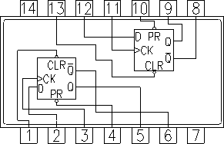
IC 7474 – Dual D Type Positive Edge triggered FF
IC 7474 – Dual Positive Edge triggered D Flip Flop with PRESET and CLEAR.
These IC contain two independent D-type positive edge triggered flip flops.
‹#›

Slide 95

IC 7474 – Dual D Type Positive Edge triggered FF
PR
PR
4
10
2
5
12
9
D
Q
D
Q
D-FF
D-FF
CLK
Q
6
CLK
Q
8
3
11
1
13
CR
CR
+Vcc = Pin 14
^{G}ND
= Pin 7
110

Slide 96
IC 7474 – Dual D Type Positive Edge triggered FF
Operating Mode | Inputs |  |  | Outputs
 | PR | CR | D | Q | Q
Preset | L | H | X | H | L
Clear | H | L | X | L | H
Undetermined | L | L | X | H | H
Set | H | H | H | H | L
Reset | H | H | L | L | H
111

Slide 97
IC 7476- Dual Master-Slave J-K Flip-Flops with Clear,
Preset, and Complementary Outputs
This device contains two independent positive pulse triggered J-
K flip-flops with complementary outputs.
The J and K data is processed by the flip-flop after a complete clock pulse.
While the clock is LOW the slave is isolated from the master. On the positive transition of the clock, the data from the J and K inputs is transferred to the master.
While the clock is HIGH the J and K inputs are disabled. On the negative transition of the clock, the data from the master is transferred to the slave.
The logic state of J and K inputs must not be allowed to change while the clock is HIGH. The data is transferred to the outputs on the falling edge of the clock pulse.
A LOW logic level on the preset or clear inputs will set or reset
^{9/}t¹¹h^{/2}e⁰¹⁸outputs regardless of the levels of the other inputs.
112

Slide 98
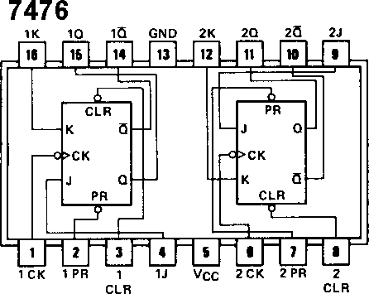
IC 7476 – Dual JK Flip Flop with Set and Clear
Logic Diagram:

Slide 99
IC 7476 – Dual JK Flip Flop with Set and Clear
PR
PR
2
7
16
15
12
11
 | K Q D-FF J _{Q}
1
4
 | K Q D-FF J _{Q}
6
9
CLK
CLK
14
10
3
8
CR
CR
+Vcc = Pin 5
^{G}ND
= Pin 13

Slide 100
IC 7476 – Dual JK Flip Flop with Set and Clear
Operating Mode | Inputs |  |  |  | Outputs
 | PR | CR | J | K | Q | Q
Preset | L | H | X | X | H | L
Clear | H | L | X | X | L | H
Undetermined | L | L | X | X | H | H
Toggle | H | H | H | H | Q | Q
Reset | H | H | L | H | L | H
Set | H | H | H | L | H | L
Hold | H | H | L | L | Q | Q

Slide 101
IC 7475 - Quad Latches
These latches are ideally suited for use as temporary storage for binary information between processing units and input/output or indicator units.
Information present at a data (D) input is transferred to the Q input when the enable (G) is high, and the Q output will follow the data input as long as the enable remains high.
When the enable goes low, the information (that was present at the data input at the time the transition occurred) is retained at the Q output until the enable is permitted to go high.
These latches feature complementary Q and Q outputs from a 4-bit latch and are available in 16-pin packages.

Slide 102
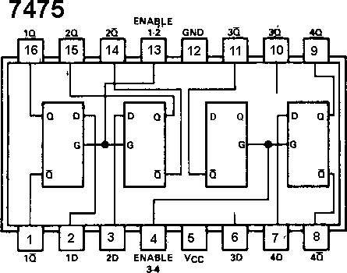
IC 7475 - Quad Latches
Logic Diagram:

Slide 103
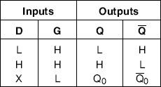
IC 7475 - Quad Latches
Function Table:

Slide 104
IC 74373- Octal D-Type Transparent Latches and Edge-
Triggered Flip-Flops
These 8-bit registers feature totem-pole TRI-STATE outputs
designed specifically for driving highly-capacitive or relatively low-impedance loads.
The high-impedance state and increased high-logic level drive provide these registers with the capability of being connected directly to and driving the bus lines in a bus-organized system without need for interface or pull-up components.
They are particularly attractive for implementing buffer registers, I/O ports, bidirectional bus drivers, and working registers.

Slide 105
IC 74373- Octal D-Type Transparent Latches and Edge-
Triggered Flip-Flops
Features:
Choice of 8 latches or 8 D-type flip-flops in a single package
TRI-STATE bus-driving outputs
Full parallel-access for loading
Buffered control inputs
P-N-P inputs reduce D-C loading on data lines
120

Slide 106
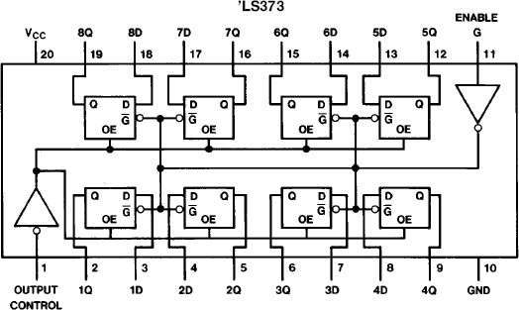
IC 74373- Octal D-Type Transparent Latches and Edge-
Triggered Flip-Flops
Internal Diagram:

Slide 107
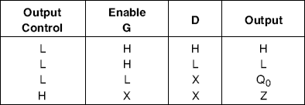
IC 74373- Octal D-Type Transparent Latches and Edge-
Triggered Flip-Flops
Function Table:

Slide 108
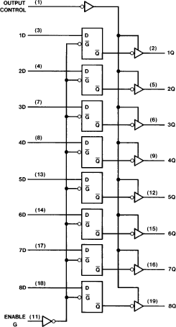
IC 74373- Octal D-Type Transparent Latches and Edge-
Triggered Flip-Flops
Logic Diagram:

Slide 109
Unit III – Sequential Logic Circuit
Shift Register: Logic diagram of 4 bit shift registers - SISO, SIPO,
PIPO, PISO, 4 Bit Universal Shift Registers.
Counters: Asynchronous Counter: 4 bit Ripple Counter, 4 Bit Up/Down Counter, Modulus of counter, Synchronous Counter: Design of 4 bit Synchronous up/down counter. Decade Counter: Block schematic of IC 7490, IC 7490 as MOD-N Counter, Ring Counter and Twisted Ring Counter

Slide 110
Serial form of Data Vs Parallel Form of Data
Data may be available in Parallel form or Serial form.
Multi bit data is said to be in parallel form when all the bits are available (accessible) simultaneously.
The data is said to be in serial form when data bits appear sequentially (one after another in time) at a single terminal.
Data may also be transferred in parallel form or in serial form.

Slide 111
Data Transmission Serial/Parallel
Parallel data transfer is the simultaneous transmission of all bits of data from one device to another.
Serial data transfer is the transmission of one bit of data at time from one device to another.
Serial data must be transmitted under the synchronization of a clock, since clock provides the means to specify the time at which each new bit is sampled

Slide 112
Register
As a flip flop can store only one bit of data, a 0 or a 1, it is referred as a single bit register.
When more bits of data are to be stored, a number of FFs used.
A register is a set of FFs used to store binary data.
The storage capacity of a register is the number of bits (1s and 0s) of digital data it can retain.
A register may output data either in serial form or in parallel form.

Slide 113
Shift Register
A shift register is a very important digital building blocks. It has innumerable applications.
Shift registers are a type of logic circuits closely related to counters.
They are used basically for storage and transfer of digital data.
The basic difference between a shift register and a counter is that, a shift register has no specified sequence of states whereas a counter has a specified sequence of states.

Slide 114
Shift Registers
Multi-bit register that moves stored data bits left/right ( 1 bit position per clock cycle)
Shift Left is towards MSB
^{Q}₃ ^{Q}₂ ^{Q}₁ Q₀
Q₃
Q₂
Q₁
Q₀
0 | 1 | 1 | 1
LSI
1 | 1 | 1 | LSI
Shift Right (or Shift Up) is towards MSB
^{Q}₃ ^{Q}₂ ^{Q}₁ Q₀
Q₃
Q₂
Q₁
Q₀
RSI
0 | 1 | 1 | 1
RSI | 0 | 1 | 1

Slide 115
Flip Flop as Storage Element
Inputs |  | Output |  | Comment
CLK | D | Qn + 1 | Qn + 1
0 | X | Qn | Qn | Last Value or No Change
 | 0 | 0 | 1 | Reset
 | 1 | 1 | 0 | Set
D
Q
CLK
D-FF
Q
130

Slide 116
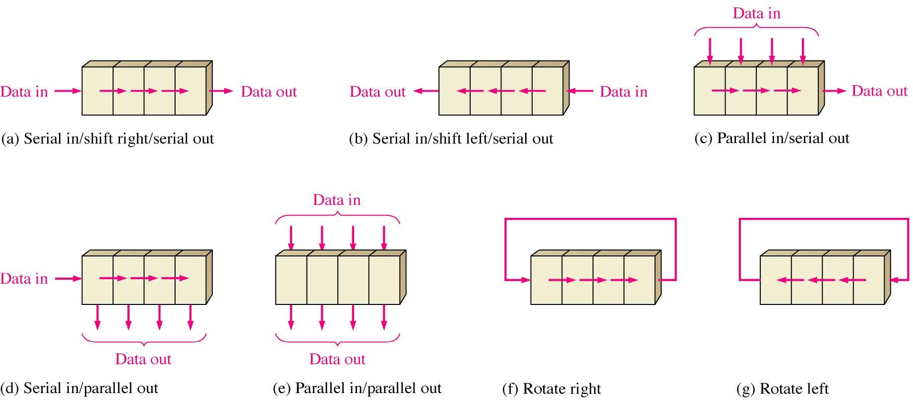
Basic Data Movements in Shift Registers

Slide 117
Types of Shift Registers
SISO – Serial In Serial Out Shift Register
SIPO – Serial In Parallel Out Shift Register
PISO – Parallel In Serial Out Shift Register
PIPO – Parallel In Parallel Out Shift Register
Bi-directional Shift Register
Universal Shift Register

Slide 118
Unit III – Sequential Logic Circuit
Shift Register: Logic diagram of 4 bit shift registers - SISO, SIPO,
PIPO, PISO, 4 Bit Universal Shift Registers.
Counters: Asynchronous Counter: 4 bit Ripple Counter, 4 Bit Up/Down Counter, Modulus of counter, Synchronous Counter: Design of 4 bit Synchronous up/down counter. Decade Counter: Block schematic of IC 7490, IC 7490 as MOD-N Counter, Ring Counter and Twisted Ring Counter

Slide 119
SISO – Serial In Serial Out Shift Register (Shift Left)
Serial Data
Serial Data Output
Input ^{D}IN
D₀ Q₀
D₁ Q₁
D₂ Q₂
D₃ Q₃
D-FF0
D-FF1
D-FF2
D-FF3
Q₀
Q₁
Q₂
Q₃
CLK

Slide 120
SISO – Serial In Serial Out Shift Register (Shift Left)
CLK | Q₃ | Q₂ | Q₁ | Q₀ | Serial Input D_{IN} = D₀
Initially | 0 | 0 | 0 | 0
₁st | 0 | 0 | 0 | 1 | 1
₂nd | 0 | 0 | 1 | 1 | 1
₃rd | 0 | 1 | 1 | 1 | 1
₄th | 1 | 1 | 1 | 1 | 1

Slide 121
SISO – Serial In Serial Out Shift Register (Shift Left)
Clock
^{D}IN
FF-0 Sets
Q₀
FF-1 Sets
-------------------------------------------------------------------------------------
-------------------------------------------------------------------------------------
-------------------------------------------------------------------------------------
Q₁
-------------------------------------------------------------------------------------
FF-2 Sets
Q₂
FF-3 Sets
Q₃
0000
0001
0011
0111
1111

Slide 122
SISO – Serial In Serial Out Shift Register (Shift Right)
Serial Data
Serial Data Output
Input ^{D}IN
D₃ Q₃
D₂ Q₂
D₁
Q₁
D₀
Q₀
D-FF3
D-FF2
D-FF1
D-FF0
Q₃
Q₂
Q₁
Q₀
CLK

Slide 123
SISO – Serial In Serial Out Shift Register (Shift Right)
CLK | Serial Input D_{IN} = D₀ | Q₃ | Q₂ | Q₁ | Q₀
Initially |  | 0 | 0 | 0 | 0
₁st | 1 | 1 | 0 | 0 | 0
₂nd | 1 | 1 | 1 | 0 | 0
₃rd | 1 | 1 | 1 | 1 | 0
₄th | 1 | 1 | 1 | 1 | 1

Slide 124
SISO – Serial In Serial Out Shift Register (Shift Right)
Clock
^{D}IN
FF-3 Sets
Q₃
FF-2 Sets
-------------------------------------------------------------------------------------
-------------------------------------------------------------------------------------
-------------------------------------------------------------------------------------
Q₂
-------------------------------------------------------------------------------------
FF-1 Sets
Q₁
FF-0 Sets
Q₀
0000
1000
1100
1110
1111

Slide 125
Unit III– Sequential Logic Circuit
Shift Register: Logic diagram of 4 bit shift registers - SISO, SIPO,
PIPO, PISO, 4 Bit Universal Shift Registers.
Counters: Asynchronous Counter: 4 bit Ripple Counter, 4 Bit Up/Down Counter, Modulus of counter, Synchronous Counter: Design of 4 bit Synchronous up/down counter. Decade Counter: Block schematic of IC 7490, IC 7490 as MOD-N Counter, Ring Counter and Twisted Ring Counter
140

Slide 126
SIPO – Serial In Parallel Out Shift Register
Serial Data
Input
^{D}IN
D₀ Q₀
D₁ Q₁
D₂ Q₂
D₃ Q₃
D-FF0
D-FF1
D-FF2
D-FF3
Q₀
Q₁
Q₂
Q₃
CLK
Q₀
Q₁
Q₂
Q₃
Parallel Outputs

Slide 127
Unit III– Sequential Logic Circuit
Shift Register: Logic diagram of 4 bit shift registers - SISO, SIPO,
PIPO, PISO, 4 Bit Universal Shift Registers.
Counters: Asynchronous Counter: 4 bit Ripple Counter, 4 Bit Up/Down Counter, Modulus of counter, Synchronous Counter: Design of 4 bit Synchronous up/down counter. Decade Counter: Block schematic of IC 7490, IC 7490 as MOD-N Counter, Ring Counter and Twisted Ring Counter

Slide 128
PIPO – Parallel In Parallel Out Shift Register
Parallel Data Input
D₀
D₁
D₂
D₃
D₀ Q₀
D₁ Q₁
D₂ Q₂
D₃ Q₃
D-FF0
D-FF1
D-FF2
D-FF3
Q₀
Q₁
Q₂
Q₃
CLK
Q₀
Q₁
Q₂
Q₃
Parallel Outputs

Slide 129
Unit III – Sequential Logic Circuit
Shift Register: Logic diagram of 4 bit shift registers - SISO, SIPO,
PIPO, PISO, 4 Bit Universal Shift Registers.
Counters: Asynchronous Counter: 4 bit Ripple Counter, 4 Bit Up/Down Counter, Modulus of counter, Synchronous Counter: Design of 4 bit Synchronous up/down counter. Decade Counter: Block schematic of IC 7490, IC 7490 as MOD-N Counter, Ring Counter and Twisted Ring Counter

Slide 130
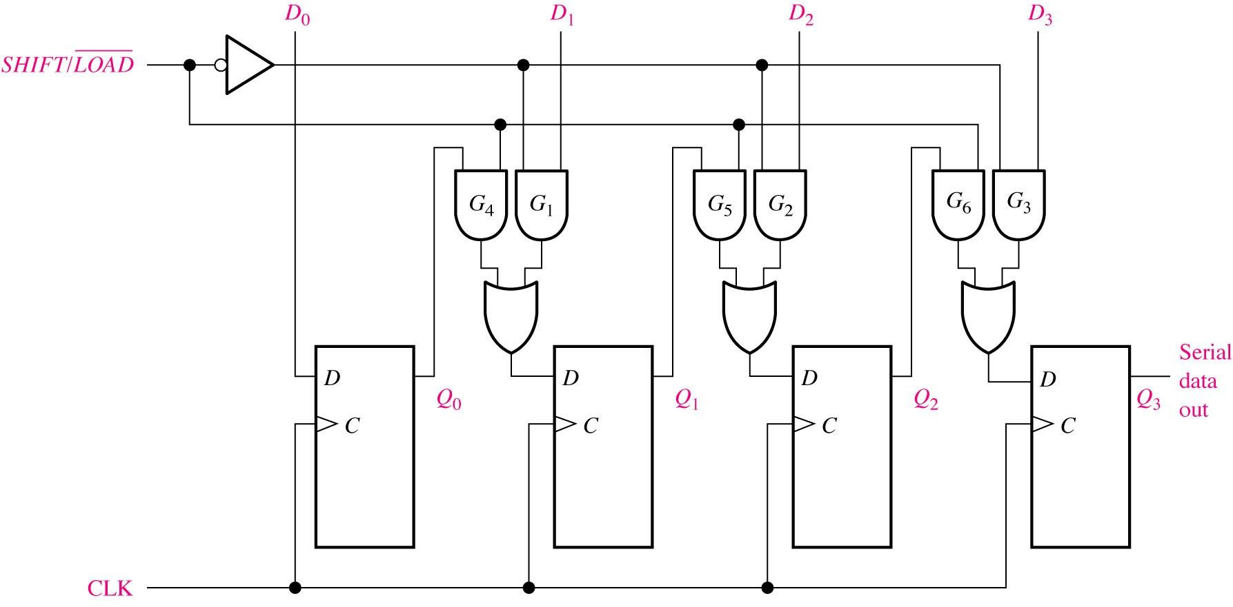
PISO – Parallel In Serial Out Shift Register

Slide 131
PISO – Parallel In Serial Out Shift Register
Load Mode:
When the ^{Shift / Load} line is Low, the AND gates G1, G2 and G3 become active. They will pass D1, D2, and D3 bits to the corresponding Flip Flops.
On the low going edge of clock, the binary inputs D0, D1, D2 and D3 will get loaded into corresponding flip flops. Thus parallel loading takes place.

Slide 132
PISO – Parallel In Serial Out Shift Register
Shift Mode:
When the ^{Shift / Load} line is High, the AND gates G1, G2 and G3 become inactive. Hence parallel loading of data becomes impossible.
But AND gates G4, G5 and G6 become active. Therefore the shifting of data from left to right bit by bit on application of clock pulses
Thus the parallel in serial out operation takes place

Slide 133
Unit III– Sequential Logic Circuit
Shift Register: Logic diagram of 4 bit shift registers - SISO, SIPO,
PIPO, PISO, 4 Bit Universal Shift Registers.
Counters: Asynchronous Counter: 4 bit Ripple Counter, 4 Bit Up/Down Counter, Modulus of counter, Synchronous Counter: Design of 4 bit Synchronous up/down counter. Decade Counter: Block schematic of IC 7490, IC 7490 as MOD-N Counter, Ring Counter and Twisted Ring Counter

Slide 134
4 Bit Bi-directional Shift Register
A bi directional shift register is one in which the data bits can be shifted from left to right or from right to left.

Slide 135
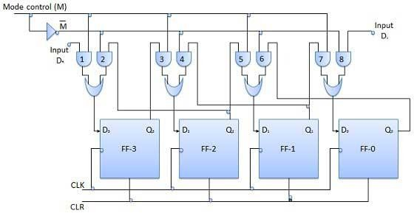
4 Bit Bi-directional Shift Register
Serial shift
Left input
Serial shift
right input
150

Slide 136
4 Bit Bi-directional Shift Register
With M = 1: Shift Right Operation
If M=1, then the AND gates 1,3,5 and 7 are enabled whereas the remaining AND gates 2,4,6 and 8 will be disabled.
Hence the data at shift right input is shifted to right bit by bit from FF-3 to FF-0 on the application of clock pulses.
Thus with M=1 we get the serial right shift operation.

Slide 137
4 Bit Bi-directional Shift Register
With M = 0: Shift Left Operation
If M=0, then the AND gates 2,4,6 and 8 are enabled whereas the remaining AND gates 1,3,5 and 7 will be disabled.
Hence the data at shift left input is shifted to left bit by bit from FF-0 to FF-3 on the application of clock pulses.
Thus with M=0 we get the serial left shift operation.

Slide 138
4 Bit Universal Shift Register
A register capable of shifting in one direction only is a unidirectional shift register.
One that can shift in both directions is a bidirectional shift register.
If the register has both shifts and parallel load capabilities, it is referred to as a “Universal Shift Register”.
So universal shift register is a bidirectional shift register, whose output can be either in serial form or in parallel form and whose output also can be either in serial form or parallel form.

Slide 139
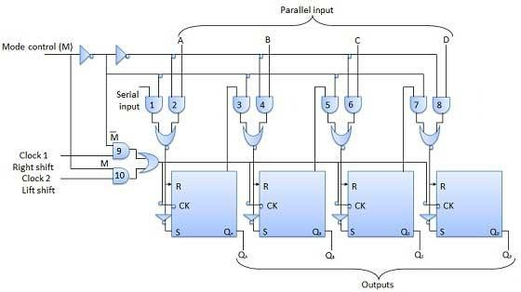
4 Bit Universal Shift Register

Slide 140
Applications of Shift Registers
For temporary data storage
As a delay line
Parallel to Serial Converter
Serial to Parallel Converter
Ring Counter
Twisted Ring Counter (Johnson Counter)

Slide 141
Unit III – Sequential Logic Circuit
Shift Register: Logic diagram of 4 bit shift registers - SISO, SIPO,
PIPO, PISO, 4 Bit Universal Shift Registers.
Counters: Asynchronous Counter: 4 bit Ripple Counter, 4 Bit Up/Down Counter, Modulus of counter, Synchronous Counter: Design of 4 bit Synchronous up/down counter. Decade Counter: Block schematic of IC 7490, IC 7490 as MOD-N Counter, Ring Counter and Twisted Ring Counter

Slide 142
Counter
A digital counter is a set of flip flops whose states changes in response to pulses applied at the input to counter.
The FFs are interconnected such that their combined state at any time is the binary equivalent of the total number of pulses that have occurred up to that time.
Thus, as its name implies, a counter is used to count pulses.

Slide 143
Types of Counters
Counters
Asynchronous Counters
Synchronous Counters
Asynchronous or Ripple Counter: For these counters the external clock signal is applied to one Flip Flop and then the output of preceding flip flop is connected to the clock of the next flip flop.
Synchronous Counter: In synchronous counters all the flip flops receive the external clock pulse simultaneously.

Slide 144
Unit III – Sequential Logic Circuit
Shift Register: Logic diagram of 4 bit shift registers - SISO, SIPO,
PIPO, PISO, 4 Bit Universal Shift Registers.
Counters: Asynchronous Counter: 4 bit Ripple Counter, 4 Bit Up/Down Counter, Modulus of counter, Synchronous Counter: Design of 4 bit Synchronous up/down counter. Decade Counter: Block schematic of IC 7490, IC 7490 as MOD-N Counter, Ring Counter and Twisted Ring Counter

Slide 145
Asynchronous Vs Synchronous Counter
^{Asynchronous Counter} Synchronous Counter
Output of the preceding Flip Flop is connected to clock of the next Flip Flop.
There is no connection between output of preceding Flip Flop and Clock of next one.
All the Flip Flops receive clock signal simultaneously.
With increase in number of states, the logic circuit becomes complicated.
All the Flip Flops are not clocked simultaneously.
Logic circuit is simple.
160

Slide 146
Asynchronous Vs Synchronous Counter
^{Asynchronous Counter} Synchronous Counter
P.D. = n X (t_{d}) where n is number of Flip Flops and t_{d} is propagation delay of flip flop.
P.D. = (t_{d})_{FF} + (t_{d})_{Gate} ,It is much shorter than that of asynchronous counter.
Frequency of operation is low because of the long propagation delay
Frequency of operation is high due to shorter
propagation delay.

Slide 147

2 Bit Asynchronous or Ripple Up Counter
Logic 1
T_{A}
PR _{QA}
T_{B}
PR _{QB}
CLK
FF-A
FF-B
CR ^{QA}
CR ^{QB}
Logic 1
(LSB)
Q_{A}
Q_{B} (MSB)
Counter Outputs

Slide 148
2 Bit Asynchronous or Ripple Up Counter
Clock | Counter Outputs |  | State Number | Decimal Equivalent of Counter Output
 | Q_{B} (MSB) | Q_{A} (LSB)
Initially | 0 | 0 | - | 0
₁st | 0 | 1 | 1 | 1
₂nd | 1 | 0 | 2 | 2
₃rd | 1 | 1 | 3 | 3
₄th | 0 | 0 | 4 | 0

Slide 149
2 Bit Asynchronous or Ripple Up Counter
Clock
Q_{A}
0
1
0
1
0
Q_{B}
0
0
1
1
0
Counter O/P
Q_{B} Q_{A}
00 | 01 | 10 | 11 | 00
0 | 1 | 2 | 3 | 0

Slide 150
2 Bit Asynchronous or Ripple Up Counter
Number of States: 2 Bit ripple counter has four distinct states of outputs namely 00,01,10 and 11.
- In general the number of states = 2^{n}, where n is the number of flip flops.
Maximum Count is 3 (decimal) i.e. 11 binary
- In general the maximum count = (2^{n}-1)

Slide 151
State diagram of 2 bit Ripple Counter
The state diagram of a counter represents the states of a
counter graphically.
For example, for a 2 bit ripple counter the state diagram is shown below.
Initial
State
0 1
3
2
Arrow indicates the
direction

Slide 152


3 Bit Asynchronous or Ripple Up Counter
Logic 1
T_{A}
PR _{QA}
T_{B}
PR _{QB}
T_{C}
PR _{QC}
CLK
FF-A
FF-B
FF-C
CR ^{QA}
CR ^{QB}
CR ^{QC}
Logic 1
Q_{A}
(LSB)
Q_{B}
Q_{C}
(MSB)
9/11/2018
Counter Outputs
167

Slide 153
3 Bit Asynchronous or Ripple Up Counter
Clock | Flip Flop Outputs |  |  | State | Decimal Equivalent
 | Q_{C} (MSB) | Q_{B} | Q_{A} (LSB)
Initial | 0 | 0 | 0 | 1 | 0
₁st | 0 | 0 | 1 | 2 | 1
₂nd | 0 | 1 | 0 | 3 | 2
₃rd | 0 | 1 | 1 | 4 | 3
₄th | 1 | 0 | 0 | 5 | 4
₅th | 1 | 0 | 1 | 6 | 5
₆th | 1 | 1 | 0 | 7 | 6
₇th | 1 | 1 | 1 | 8 | 7
₈th | 0 | 0 | 0 | 1 | 0

Slide 154
3 Bit Asynchronous or Ripple Up Counter
Clock
Q_{A}
0
1
0
1
0
1
0
1
0
0 | 0 | 1 | 1 | 0 | 0 | 1 | 1 | 0
Q_{B}
Q_{C}
0
0
0
0
1
1
1
1
0
Counter O/P Q_{C} Q_{B} Q_{A}
000 | 001 | 010 | 011 | 100 | 101 | 110 | 111 | 000
0 | 1 | 2 | 3 | 4 | 5 | 6 | 7 | 0

Slide 155
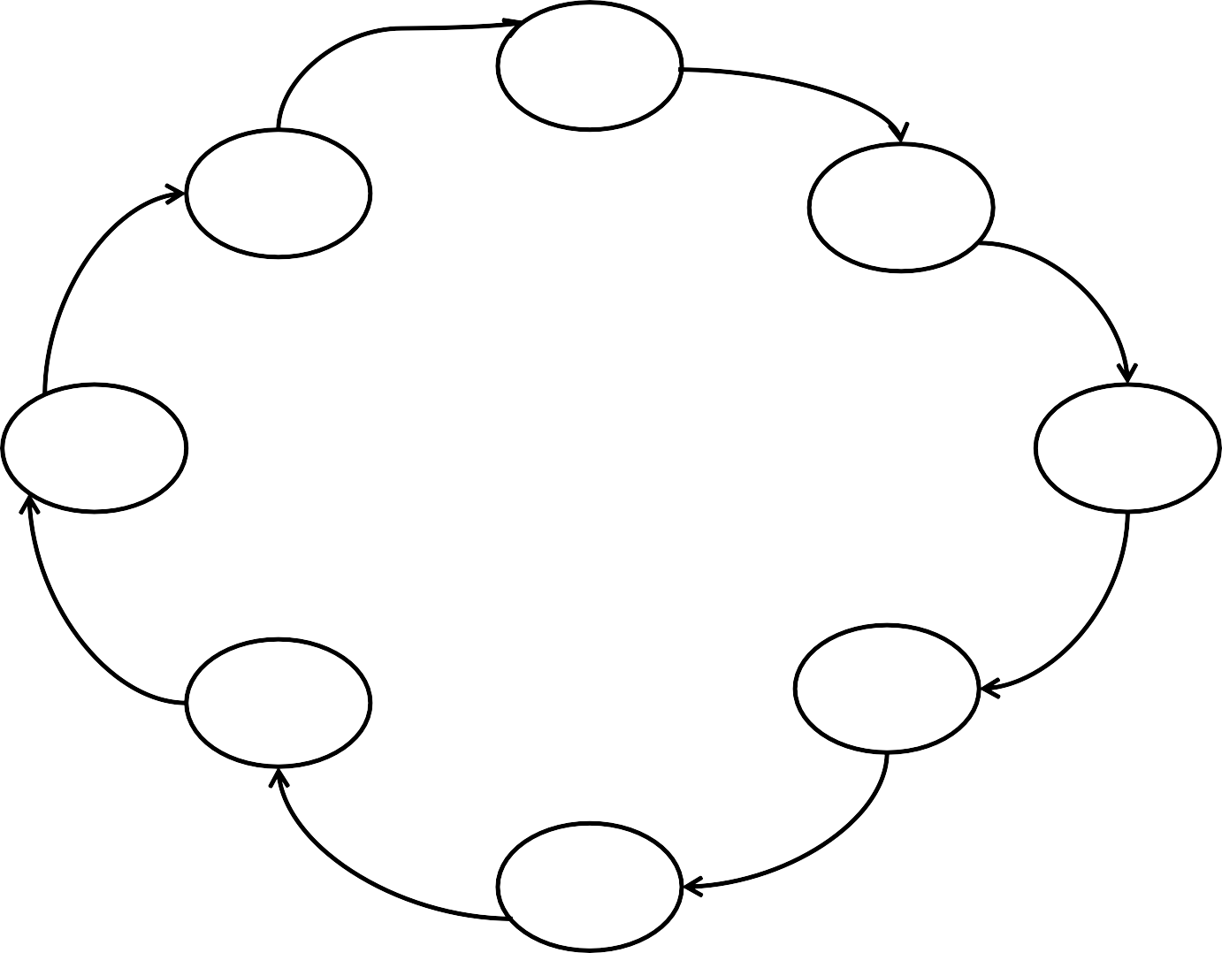
State diagram of 3 bit Asynchronous Up Counter
000
111
001
110
010
101
011
100
170

Slide 156



4 Bit Asynchronous or Ripple Up Counter
Logic 1
_{TA} PR _{QA}
FF-A CR ^{QA}
_{TB} PR _{QB}
FF-B CR^{QB}
_{TC} PR _{QC}
FF-C
Q_{C}
CR
_{TD} PR _{QD}
FF-D
CR ^{QD}
CLK
Logic 1
Q_{A}
(LSB)
Q_{B}
Q_{C}
Q_{D}
(MSB)
Counter Outputs

Slide 157
4 Bit Asynchronous or Ripple Up Counter
Clock
Q_{A}
Q_{B}
Q_{C}
Q_{D}
Counter O/P
Q_{D} Q_{C} Q_{B} Q_{A}
0 0 0 0 | 0 0 0 1 | 0 0 1 0 | 0 0 1 1 | 0 1 0 0 | 0 1 0 1 | 0 1 1 0 | 0 1 1 1 | 1 0 0 0 | 1 0 0 1 | 1 0 1 0 | 1 0 1 1 | 1 1 0 0 | 1 1 0 1 | 1 1 1 0 | 1 1 1 1 | 0 0 0 0
0 | 1 | 2 | 3 | 4 | 5 | 6 | 7 | 8 | 9 | 10 | 11 | 12 | 13 | 14 | 15 | 00

Slide 158
Design MOD-3 Asynchronous Counter
Mod – 3 counter is a counter having three states i.e. 00, 01 and 10. After 10 it will return back to its original state 00.
Initial
State
CLR
Counter ^{Q}_{A} Q_{B}
0
CLK
2
1
Y
Reset Logic
State Diagram
Block Diagram
We have to design the reset logic which is a combinational circuit.
The output of reset logic is applied to the clear inputs of flip flops. This is an active Low input.

Slide 159
Design MOD-3 Asynchronous Counter
Truth Table of Reset Logic
FF Outputs |  | O/P of Reset Logic
Q_{B} | Q_{A} | Y
0 | 0 | 1
0 | 1 | 1
1 | 0 | 1
1 | 1 | 0
K-map & Simplification for Reset Logic
Q_{A}
QA
0
QA
1
Y = QB + QA
∴Y = QBQA
Q_{B}
1
1
QB
QB
0
1
0
1

Slide 160

Design MOD-3 Asynchronous Counter
Logic 1
2 Bit Ripple
Counter
T_{A}
PR _{QA}
T_{B}
PR _{QB}
CLK
FF-A
FF-B
CR ^{QA}
CR ^{QB}
Q_{A}
Q_{B}
Reset Logic

Slide 161
Design MOD-3 Asynchronous Counter
Clock
Q_{A}
0
1
0
0
1
Q_{B}
Y
0
0
1
0
0
Reset Pulse
Counter O/P
Q_{B} Q_{A}
00 | 01 | 10 | 00 | 01
0 | 1 | 2 | 0 | 0

Slide 162
Design MOD-5 Asynchronous Counter
Mod – 5 counter is a counter having five states i.e. 000, 001,010,011 and 100. After 100 it will return back to its original state 000.
Initial
State
0 1
3
2 4
State Diagram
We have to design the reset logic which is a combinational circuit.
The output of reset logic is applied to the clear inputs of flip flops. This is an active Low input.

Slide 163
Design MOD-5 Asynchronous Counter
Truth Table of Reset Logic K-map & Simplification for Reset Logic
Q_{B}Q_{A}
State | FF Outputs |  |  | O/P of reset logic Y
 | Q_{C} | Q_{B} | Q_{A}
0 | 0 | 0 | 0 | 1
1 | 0 | 0 | 1 | 1
2 | 0 | 1 | 0 | 1
3 | 0 | 1 | 1 | 1
4 | 1 | 0 | 0 | 1
5 | 1 | 0 | 1 | 0
6 | 1 | 1 | 0 | 0
7 | 1 | 1 | 1 | 0
Q
C
00
01
11
10
 |  |  |  |  | 1
1 |  | 1 | 1
1 |  | 0 | 0 | 0
QC
0
QC
1
Y = Qc + QBQA

Slide 164
Design MOD-5 Asynchronous Counter
Logic 1
T_{A}
PR _{QA}
T_{B}
PR _{QB}
T_{C}
PR _{QC}
CLK
FF-A
FF-B
FF-C
CR ^{QA}
CR ^{QB}
CR ^{QC}
Reset Logic

Slide 165
Unit III – Sequential Logic Circuit
Shift Register: Logic diagram of 4 bit shift registers - SISO, SIPO,
PIPO, PISO, 4 Bit Universal Shift Registers.
Counters: Asynchronous Counter: 4 bit Ripple Counter, 4 Bit Up/Down Counter, Modulus of counter, Synchronous Counter: Design of 4 bit Synchronous up/down counter. Decade Counter: Block schematic of IC 7490, IC 7490 as MOD-N Counter, Ring Counter and Twisted Ring Counter
180

Slide 166
Up Counter Vs Down Counter
The counter which count is in up direction that means the decimal equivalent of the counter output increases (0, 1, 2,………etc.) as it receives the clock pulses. Hence such counters are called as “Up Counter”.
The counter which count is in down direction that means the decimal equivalent of the counter output decreases as it receives the clock pulses. Hence such counters are called as “Down Counter”.

Slide 167
2 Bit Asynchronous or Ripple Down Counter
Logic 1
J_{A}
PR _{QA}
J_{B}
PR _{QB}
CLK
FF-A
FF-B
K_{A}
CR ^{QA}
K_{B}
CR ^{QB}
Logic 1
(LSB)
Q_{A}
Q_{B} (MSB)
Counter Outputs

Slide 168
2 Bit Asynchronous or Ripple Down Counter
Clock | Counter Outputs |  | State Number | Decimal Equivalent of Counter Output
 | Q_{B} (MSB) | Q_{A} (LSB)
Initially | 0 | 0 | - | 0
₁st | 1 | 1 | 4 | 3
₂nd | 1 | 0 | 3 | 2
₃rd | 0 | 1 | 2 | 1
₄th | 0 | 0 | 1 | 0

Slide 169
2 Bit Asynchronous or Ripple Down Counter
Clock
Q_{A}
0
1
0
1
0
Q_{B}
0
1
1
0
0
Counter O/P
Q_{B} Q_{A}
11 | 10 | 01 | 00
3 | 2 | 1 | 0

Slide 170
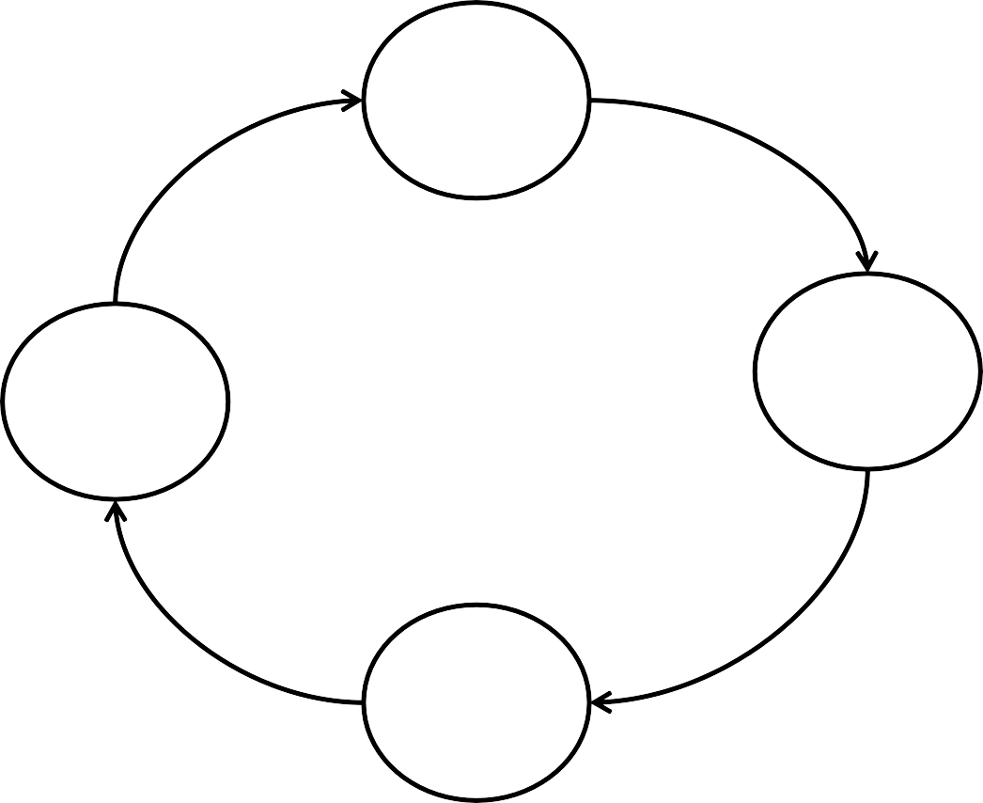
State diagram of 2 bit Ripple Down Counter
11
10
00
01

Slide 171
3 Bit Asynchronous or Ripple Down Counter
Logic 1
J_{A}
PR _{QA}
J_{B}
PR _{QB}
J_{C}
PR _{QC}
CLK
FF-A
FF-B
FF-C
K_{A}
K_{B}
K_{C}
CR ^{QA}
CR ^{QB}
CR ^{QC}
Logic 1
Q_{A}
(LSB)
Q_{B}
Q_{C}
(MSB)
9/11/2018
Counter Outputs
186

Slide 172
3 Bit Asynchronous or Ripple Down Counter
Clock | Flip Flop Outputs |  |  | State | Decimal Equivalent
 | Q_{C} (MSB) | Q_{B} | Q_{A} (LSB)
Initial | 0 | 0 | 0 | - | 0
₁st | 1 | 1 | 1 | 8 | 7
₂nd | 1 | 1 | 0 | 7 | 6
₃rd | 1 | 0 | 1 | 6 | 5
₄th | 1 | 0 | 0 | 5 | 4
₅th | 0 | 1 | 1 | 4 | 3
₆th | 0 | 1 | 0 | 3 | 2
₇th | 0 | 0 | 1 | 2 | 1
₈th | 0 | 0 | 0 | 1 | 0
₉th | 1 | 1 | 1 | 8 | 7

Slide 173
3 Bit Asynchronous or Ripple Down Counter
Clock
Q_{A}
0
1
0
1
0
1
0
1
0
0 | 1 | 1 | 0 | 0 | 1 | 1 | 0 | 0
Q_{B}
Q_{C}
Counter O/P Q_{C} Q_{B} Q_{A}
0 | 1 | 1 | 1 | 1 | 0 | 0 | 0 | 0
000 | 111 | 110 | 101 | 100 | 011 | 010 | 001 | 000
0 | 1 | 2 | 3 | 4 | 5 | 6 | 7 | 0

Slide 174
State diagram of 3 bit Asynchronous Down Counter
111
000
110
001
101
010
100
011

Slide 175
4 Bit Asynchronous or Ripple Down Counter
Logic 1
_{TA} PR _{QA}
FF-A CR ^{QA}
_{TB} PR _{QB}
FF-B CR^{QB}
_{TC} PR _{QC}
FF-C
Q_{C}
CR
_{TD} PR _{QD}
FF-D
CR ^{QD}
CLK
Logic 1
Q_{A}
(LSB)
Q_{B}
Q_{C}
Q_{D}
(MSB)
Counter Outputs
190

Slide 176
4 Bit Asynchronous or Ripple Down Counter
Clock
Q_{A}
Q_{B}
Q_{C}
Q_{D}
Counter O/P
Q_{D} Q_{C} Q_{B} Q_{A}
0 0 0 0 | 1 1 1 1 | 1 1 1 0 | 1 1 0 1 | 1 1 0 0 | 1 0 1 1 | 1 0 1 0 | 1 0 0 1 | 1 0 0 0 | 0 1 1 1 | 0 1 1 0 | 0 1 0 1 | 0 1 0 0 | 0 0 1 1 | 0 0 1 0 | 0 0 0 1 | 0 0 0 0
0 | 15 | 14 | 13 | 12 | 11 | 10 | 9 | 8 | 7 | 6 | 5 | 4 | 3 | 2 | 1 | 0

Slide 177
Up/Down Ripple Counter
In Up/Down ripple counter, the counter can be used as UP counter as well as Down Counter.
Up Counting Mode (M=0): The Q output of the preceding Flip Flop is connected to the clock of the next stage if up counting is to be achieved. For this mode, the mode select input M is at logic 0.
Down Counting Mode (M=1): The output of the
Q
preceding Flip Flop is connected to the clock of the next stage if down counting is to be achieved. For this mode, the mode select input M is at logic 1.

Slide 178




4 Bit Ripple Up/Down Counter
M
Logic 1
T_{D} Q_{D}
T_{C} Q_{C}
T_{B} Q_{B}
T_{A} Q_{A}
FF-D
FF-C
CLK
FF-B
Q_{D}
FF-A
Q_{C}
Q_{B}
Q_{A}
M=0 : Up Counter M=1 : Down Counter

Slide 179
Disadvantages of Ripple Counter
Every flip flop has its own propagation delay. In ripple counter the output of the previous flip flop is used as clock for the next flip flop. Hence the propagation delay goes on accumulating.
The propagation delay goes on increasing with increase in number of flip flops.
This will put a limitation on the maximum clock frequency.
The frequency ‘f’ of a clock pulse for reliable operation of the
counter is given by;
1
f ≤
n(td ) + Ts
Where n = number of flip flops
Ts = width of strobe pulse
td = propagation delay of one flip flop

Slide 180
Frequency Division in Ripple Counter
In ripple counter, a flip flop in toggle mode divides the clock frequency by 2.
That means the frequency of Q and Q output of a toggle flip flop is exactly half of the clock frequency.
The concept of frequency division is observed in counters where flip flops used in toggle mode.

Slide 181
Frequency Division in Ripple Counter
Clock
T
Q_{A}
0
1
0
1
0
1
0
1
0
2T
0 | 1 | 1 | 0 | 0 | 1 | 1 | 0 | 0
Q
B
4T
0 | 1 | 1 | 1 | 1 | 0 | 0 | 0 | 0
Q_{C}
8T

Slide 182
Unit III – Sequential Logic Circuit
Shift Register: Logic diagram of 4 bit shift registers - SISO, SIPO,
PIPO, PISO, 4 Bit Universal Shift Registers.
Counters: Asynchronous Counter: 4 bit Ripple Counter, 4 Bit Up/Down Counter, Modulus of counter, Synchronous Counter: Design of 4 bit Synchronous up/down counter. Decade Counter: Block schematic of IC 7490, IC 7490 as MOD-N Counter, Ring Counter and Twisted Ring Counter

Slide 183
Modulus of Counter
The modulus of a counter represents the number of states
through which the counter progresses during its operation.
So in general, an n bit ripple counter has MOD number:
∴ MOD No. = 2^{n}
For example, 2 bit ripple counter is called as MOD-4 counter because the counter represents 4 states during its operation.
For example, 3 bit ripple counter is called as MOD-8 counter because the counter represents 8 states during its operation.

Slide 184
Unit III– Sequential Logic Circuit
Shift Register: Logic diagram of 4 bit shift registers - SISO, SIPO,
PIPO, PISO, 4 Bit Universal Shift Registers.
Counters: Asynchronous Counter: 4 bit Ripple Counter, 4 Bit Up/Down Counter, Modulus of counter, Synchronous Counter: Design of 4 bit Synchronous up/down counter. Decade Counter: Block schematic of IC 7490, IC 7490 as MOD-N Counter, Ring Counter and Twisted Ring Counter

Slide 185
2 Bit Synchronous Up Counter
Logic 1
J_{A}
Q_{A}
J_{B}
Q_{B}
FF-A
FF-B
K_{A}
Q_{A}
K_{B}
Q_{B}
CLK
(LSB)
Q_{A}
Q_{B} (MSB)
Counter Outputs

Slide 186
2 Bit Synchronous Up Counter
Clock | Counter Outputs |  | State Number | Decimal Equivalent of Counter Output
 | Q_{B} (MSB) | Q_{A} (LSB)
Initially | 0 | 0 | - | 0
₁st | 0 | 1 | 1 | 1
₂nd | 1 | 0 | 2 | 2
₃rd | 1 | 1 | 3 | 3
₄th | 0 | 0 | 4 | 0

Slide 187
2 Bit Synchronous Up Counter
Clock
Q_{A}
0
1
0
1
0
Q_{B}
0
0
1
1
0
Counter O/P
Q_{B} Q_{A}
00 | 01 | 10 | 11 | 00
0 | 1 | 2 | 3 | 0

Slide 188
3 Bit Synchronous Up Counter
Logic 1
J_{A}
Q_{A}
J_{B}
Q_{B}
J_{C}
Q_{C}
FF-A
FF-B
FF-C
K_{A}
Q_{A}
K_{B}
Q_{B}
K_{C}
Q_{C}
CLK
Q_{C}
(MSB)
Q_{A}
(LSB)
Q_{B}
Counter Outputs

Slide 189
3 Bit Synchronous Up Counter
Clock | Flip Flop Outputs |  |  | State | Decimal Equivalent
 | Q_{C} (MSB) | Q_{B} | Q_{A} (LSB)
Initial | 0 | 0 | 0 | 1 | 0
₁st | 0 | 0 | 1 | 2 | 1
₂nd | 0 | 1 | 0 | 3 | 2
₃rd | 0 | 1 | 1 | 4 | 3
₄th | 1 | 0 | 0 | 5 | 4
₅th | 1 | 0 | 1 | 6 | 5
₆th | 1 | 1 | 0 | 7 | 6
₇th | 1 | 1 | 1 | 8 | 7
₈th | 0 | 0 | 0 | 1 | 0

Slide 190
3 Bit Synchronous Up Counter
Clock
Q_{A}
0
1
0
1
0
1
0
1
0
0 | 0 | 1 | 1 | 0 | 0 | 1 | 1 | 0
Q_{B}
Q_{C}
0
0
0
0
1
1
1
1
0
Counter O/P Q_{C} Q_{B} Q_{A}
000 | 001 | 010 | 011 | 100 | 101 | 110 | 111 | 000
0 | 1 | 2 | 3 | 4 | 5 | 6 | 7 | 0

Slide 191
State diagram of 3 bit Synchronous Up Counter
000
111
001
110
010
101
011
100

Slide 192
3 Bit Synchronous Down Counter
Logic 1
J_{A}
Q_{A}
J_{B}
Q_{B}
J_{C}
Q_{C}
FF-A
FF-B
FF-C
K_{A}
Q_{A}
K_{B}
Q_{B}
K_{C}
Q_{C}
CLK
Q_{C}
(MSB)
Q_{A}
(LSB)
Q_{B}
Counter Outputs

Slide 193
3 Bit Synchronous Down Counter
Clock | Flip Flop Outputs |  |  | State | Decimal Equivalent
 | Q_{C} (MSB) | Q_{B} | Q_{A} (LSB)
Initial | 0 | 0 | 0 | - | 0
₁st | 1 | 1 | 1 | 8 | 7
₂nd | 1 | 1 | 0 | 7 | 6
₃rd | 1 | 0 | 1 | 6 | 5
₄th | 1 | 0 | 0 | 5 | 4
₅th | 0 | 1 | 1 | 4 | 3
₆th | 0 | 1 | 0 | 3 | 2
₇th | 0 | 0 | 1 | 2 | 1
₈th | 0 | 0 | 0 | 1 | 0
₉th | 1 | 1 | 1 | 8 | 7

Slide 194
3 Bit Synchronous Down Counter
Clock
Q_{A}
0
1
0
1
0
1
0
1
0
0 | 1 | 1 | 0 | 0 | 1 | 1 | 0 | 0
Q_{B}
Q_{C}
Counter O/P Q_{C} Q_{B} Q_{A}
0 | 1 | 1 | 1 | 1 | 0 | 0 | 0 | 0
000 | 111 | 110 | 101 | 100 | 011 | 010 | 001 | 000
0 | 1 | 2 | 3 | 4 | 5 | 6 | 7 | 0

Slide 195
State diagram of 3 bit Synchronous Down Counter
111
000
110
001
101
010
100
011
210

Slide 196



3 Bit Synchronous Up/Down Counter
M
Logic 1
T_{A} Q_{A}
T_{B} Q_{B}
T_{C} Q_{C}
FF-A
FF-B
FF-C
Q_{A}
Q_{B}
Q_{C}
CLK
M=0 : Up Counter M=1 : Down Counter

Slide 197
Advantages of Synchronous Counter
As all the flip flops are clocked at the same instant, the propagation delay problem is reduced to a great extent.
The total propagation delay between the instant of application of clock edge and the instant at which the MSB output changes is equal to sum of propagation delay of one flip flop and that of one AND gate.
∴ Total Propagation Delay = td of one FF+ td of one gate
This is much less than the propagation delay of an asynchronous counter.
Due to reduced propagation delay, the synchronous counters can operate at a much higher clock frequency than the asynchronous counters.

Slide 198
Unit III – Sequential Logic Circuit
Shift Register: Logic diagram of 4 bit shift registers - SISO, SIPO,
PIPO, PISO, 4 Bit Universal Shift Registers.
Counters: Asynchronous Counter: 4 bit Ripple Counter, 4 Bit Up/Down Counter, Modulus of counter, Synchronous Counter: Design of 4 bit Synchronous up/down counter. Decade Counter: Block schematic of IC 7490, IC 7490 as MOD-N Counter, Ring Counter and Twisted Ring Counter

Slide 199
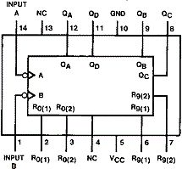
Ripple Counter IC 7490 (Decade Counter)
IC 7490 is a TTL MSI decade counter. It contains four master slave FFs and additional gating to provide a divide by two counter and three stage binary counter which provides a divide by 5 counter.
IC 7490 is a MOD-10 or decade counter. It is a 14 pin IC.

Slide 200
Internal Diagram of IC 7490
Vcc
5
^{R}0(1)
2
÷2
(MOD- 2)
÷5
(MOD- 5)
3
6
^{R}0(2)
Input A
14
R
9(1)
Clock In
^{R}9(2)
7
12
1
9 8 11
10
GND
Input B
Clock In
Q_{A}
Q_{B}
Q_{C}
Q_{D}

Slide 201
Pin Configuration of IC 7490
Pin Name | Description
Input B | This is clock input to the internal MOD -5 ripple Counter, which is negative edge triggered.
^{R}0(1)^{, R}0(2) | Reset Inputs
Vcc | +5V DC
^{R}9(1)^{, R}9(2) | Set to nine inputs
Q_{D}, Q_{C}, Q_{B} | Outputs of internal MOD – 5 Counter with Q_{D} as MSB.
GND | Ground
Q_{A} | Output of internal MOD -2 counter or FF-A
Input A | Clock input to FF-A which is negative edge triggered

Slide 202
Reset Count Truth Table
Reset Inputs |  |  |  | Outputs
^{R}0(1) | ^{R}0(2) | ^{R}9(1) | ^{R}9(2) | Q_{D} | Q_{C} | Q_{B} | Q_{A}
1 | 1 | 0 | X | 0 | 0 | 0 | 0
1 | 1 | X | 0 | 0 | 0 | 0 | 0
X | X | 1 | 1 | 1 | 0 | 0 | 1
X | 0 | X | 0 | Counter
0 | X | 0 | X | Counter
0 | X | X | 0 | Counter
X | 0 | 0 | X | Counter
Reset to 0000
Set to 1001
If CLK is applied it will count

Slide 203
IC 7490 as Decade Counter
Vcc
5
^{R}0(1)
2
÷2
(MOD- 2)
÷5
(MOD- 5)
3
6
^{R}0(2)
Input A
14
R
9(1)
Clock In
^{R}9(2)
7
12
1
9 8 11
10
Input B
Clock In
Q_{A}
Q_{B}
Q_{C}
Q_{D}

Slide 204
IC 7490 as Decade Counter
Output of MOD-5 Counter |  |  | Output of MOD-2 Counter | CLK | Count
Q_{D} | Q_{C} | Q_{B} | Q_{A} |  | Q_{D} Q_{C} Q_{B} Q_{A}
0 | 0 | 0 | 0 | 0 | 0
0 | 0 | 0 | 1 | 1 | 1
0 | 0 | 1 | 0 | 2 | 2
0 | 0 | 1 | 1 | 3 | 3
0 | 1 | 0 | 0 | 4 | 4
0 | 1 | 0 | 1 | 5 | 5
0 | 1 | 1 | 0 | 6 | 6
0 | 1 | 1 | 1 | 7 | 7
1 | 0 | 0 | 0 | 8 | 8
1 | 0 | 0 | 1 | 9 | 9

Slide 205
MOD – 6 Counter using IC 7490
Q_{C} | Q_{B} | Q_{A}
0 | 0 | 0
0 | 0 | 1
0 | 1 | 0
0 | 1 | 1
1 | 0 | 0
1 | 0 | 1
0 | 0 | 0
MOD – 6 Counter has total 6 states, as soon as output becomes 101 the IC must
reset to 000. Hence Q_{C} and Q_{A} connected to reset inputs.
220

Slide 206
MOD – 6 Counter using IC 7490
Vcc
5
^{R}0(1)
^{R}0(2)
2
Input A
÷2
(MOD- 2)
÷5
(MOD- 5)
3
6
14
R
9(1)
Clock In
^{R}9(2)
7
12
1
9 8 11
Q_{D}
10
Input B
Clock In
Q_{A}
Q_{C}
9/11/2018
221

Slide 207
Unit III – Sequential Logic Circuit
Shift Register: Logic diagram of 4 bit shift registers - SISO, SIPO,
PIPO, PISO, 4 Bit Universal Shift Registers.
Counters: Asynchronous Counter: 4 bit Ripple Counter, 4 Bit Up/Down Counter, Modulus of counter, Synchronous Counter: Design of 4 bit Synchronous up/down counter. Decade Counter: Block schematic of IC 7490, IC 7490 as MOD-N Counter, Ring Counter and Twisted Ring Counter

Slide 208
Ring Counter
D₀ PR Q₀ D₁ Q₁ D₂ Q₂ D-FF0 D-FF1 D-FF2 ^{Q0} CLR ^{Q1} CLR ^{Q2} | D₃ Q₃ D-FF3 CLR ^{Q3}
CLK
CLEAR

Slide 209
Ring Counter
CLR | CLK |  | Q₀ | Q₁ | Q₂ | Q₃
 | X |  | 1 | 0 | 0 | 0
1 |  |  | 0 | 1 | 0 | 0
1 |  |  | 0 | 0 | 1 | 0
1 |  |  | 0 | 0 | 0 | 1
1 |  |  | 1 | 0 | 0 | 0
FF-0 Preset, others cleared
The Presetted 1, follows a circular Path to form a ring

Slide 210
Ring Counter
Clock
CLR
FF-1 Set
FF-0 Reset
Q₀
FF-2 Set
FF-1 Reset
Q₁
FF-3 Set
FF-2 Reset
Q₂
FF-0 Set
FF-3 Reset
Q₃
FF-0 Preset,
⁹A^{/1}l¹l^{/2}o⁰t¹h⁸ er FFs cleared
225

Slide 211
State diagram of Ring Counter
1000
0100
0001
0010

Slide 212
Unit III – Sequential Logic Circuit
Shift Register: Logic diagram of 4 bit shift registers - SISO, SIPO,
PIPO, PISO, 4 Bit Universal Shift Registers.
Counters: Asynchronous Counter: 4 bit Ripple Counter, 4 Bit Up/Down Counter, Modulus of counter, Synchronous Counter: Design of 4 bit Synchronous up/down counter. Decade Counter: Block schematic of IC 7490, IC 7490 as MOD-N Counter, Ring Counter and Twisted Ring Counter

Slide 213
Johnson Counter (Twisted Ring Counter)
J₀
Q₀
J₁ Q₁
J₂
Q₂
J₃
Q₃
D-FF0
D-FF1
D-FF2
D-FF3
^{K0} CLR ^{Q0}
^{K1} CLR ^{Q1}
^{K2} CLR ^{Q2}
^{K3} CLR ^{Q3}
CLK
CLEAR

Slide 214
Johnson Counter (Twisted Ring Counter)
CLR | CLK | Q₃ | Q₂ | Q₁ | Q₀ | State Number | Decimal Equivalent
 | Initial | 0 | 0 | 0 | 0 | 1 | 0
1 |  | 0 | 0 | 0 | 1 | 2 | 1
1 |  | 0 | 0 | 1 | 1 | 3 | 3
1 |  | 0 | 1 | 1 | 1 | 4 | 7
1 |  | 1 | 1 | 1 | 1 | 5 | 15
1 |  | 1 | 1 | 1 | 0 | 6 | 14
1 |  | 1 | 1 | 0 | 0 | 7 | 12
1 |  | 1 | 0 | 0 | 0 | 8 | 8
1 |  | 0 | 0 | 0 | 0 | 1 | 0

Slide 215
Johnson Counter (Twisted Ring Counter)
CLR
Clock
Q₀
Q₁ Q₂
Q₃
230

Slide 216
State diagram of Twisted Ring (Johnson) Counter
0001
0011
0000
0111
1000
1111
1100
1110

Slide 217
Johnson Counter (Twisted Ring Counter)
Using D Flip Flop
D₀ Q₀ D₁ Q₁ D₂ Q₂ D-FF0 D-FF1 D-FF2 ^{Q0} CLR ^{Q1} CLR ^{Q2} | D₃ Q₃ D-FF3 CLR ^{Q3}
CLK
CLEAR

Slide 218
Johnson Counter (Twisted Ring Counter)
CLR | CLK | Q₃ | Q₂ | Q₁ | Q₀
 | Initial | 0 | 0 | 0 | 0
1 |  | 0 | 0 | 0 | 1
1 |  | 0 | 0 | 1 | 1
1 |  | 0 | 1 | 1 | 1
1 |  | 1 | 1 | 1 | 1
1 |  | 1 | 1 | 1 | 0
1 |  | 1 | 1 | 0 | 0
1 |  | 1 | 0 | 0 | 0
1 |  | 0 | 0 | 0 | 0

Slide 219

References
Digital Principles by Malvino Leach
Modern Digital Electronics by
R.P. Jain
Digital Electronics, Principles and Integrated Circuits by Anil
K. Maini
Digital Techniques by A. Anand Kumar

